Slide 1
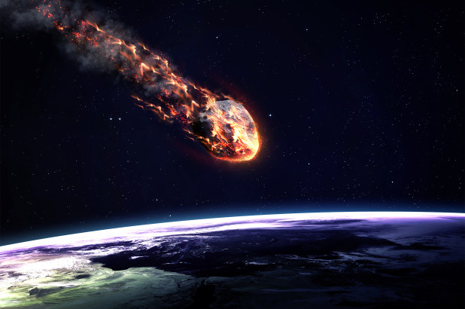
Will the asteroids kill us all?
A Team Karthik presentation
Rui Wang
Franko Ortmann
RJ Jahnke
Karthik Kurpad

Slide 2


How many asteroids are out there and are they dangerous to us?
Key questions to consider.
How many known asteroids are out there?
What makes an asteroid dangerous to us?
Does the mass or the speed of an asteroid determine if it potentially hazardous?
Are we able to find out when the next asteroid will hit us? And if so when?
Using data analysis we were able to answer most of these questions. Let’s take a look.

Slide 3

Where to get Data?
NASA’s NeoWs(Near Earth Object Web Service)
1.9M known asteroids
19,000+ near earth asteroids
EXAMPLE QUERY:
https://api.nasa.gov/neo/rest/v1/neo/browse?api_key=DEMO_KEY
Notes:
NASA’s NeoWs(Near Earth Object Web Service) is a RESTful webservice for near earth Asteroid Information NeoWs returns overall Asteroid DataSet.
There are about 1.9M known asteroids , but this API keeps track of about 19,000+ near earth asteroids to track if they are potentially hazardous or not .

Slide 4

Key variables
Is Potentially Hazardous
Minimum Orbit Intersection Distance (MOID)
Risk of a collision with Earth
Apparent magnitude
Absolute Magnitude (H)
Close Approach Date
Miss Distance
Notes:
Is Potentially Hazardous : Dangerous or not
Minimum orbit intersection distance (MOID) is a measure used in astronomy to assess potential close approaches and collision risks between astronomical objects. Of greatest interest is the risk of a collision with Earth.
Absolute magnitude (H) is a concept that was invented after apparent magnitude when astronomers needed a way to compare the intrinsic, or absolute brightness of celestial objects... Absolute magnitude is defined to be the apparent magnitude an object would have if it were located at a distance of 10 parsecs.
Close Approach Date :close approaches to the Earth by near-Earth objects
Miss Distance: distance of closest approach (miss distance) to another. moving object (target)

Slide 5

Other variables
Astronomical Unit (AU)
the mean distance from the center of the earth to the center of the sun
0.05au = 4647790 miles
PHAs(Potentially Hazardous Asteroids)
MOID<=0.05 au and Absolute Magnitude H<=22.0
Orbit Type
AMO – Amor
APO – Apollo
ATE – Aten
IEO – Interior Earth Object
Notes:
Astronomical Unit (au) : A unit of measurement equal to 149.6 million kilometers, the mean distance from the center of the earth to the center of the sun.
PHAs(Potentially Hazardous Asteroids) MOID<=0.05 au and Absolute Magnitude H<=22.0
PHA: Near Earth Asteroids(NEA) whose Minimum Orbit Intersection Distance (MOID) with the Earth is 0.05 au or less and whose absolute magnitude (H) is 22.0 or brighter(roughly 7,480,000 km or 4,650,000 mi)
Orbit Type:
AMO - Amor
Near-Earth asteroid orbits similar to that of 1221 Amor (a > 1.0 AU; 1.017 AU < q < 1.3 AU).
APO - Apollo
Near-Earth asteroid orbits which cross the Earth's orbit similar to that of 1862 Apollo (a > 1.0 AU; q < 1.017 AU).
ATE - Aten
Near-Earth asteroid orbits similar to that of 2062 Aten (a < 1.0 AU; Q > 0.983 AU).
IEO - Interior Earth Object
An asteroid orbit contained entirely within the orbit of the Earth (Q < 0.983 AU).
https://en.wikipedia.org/wiki/1221_Amor
https://en.wikipedia.org/wiki/1862_Apollo
https://en.wikipedia.org/wiki/Aten_asteroid
https://en.wikipedia.org/wiki/Atira_asteroid

Slide 6

Data cleanup and exploration
Data Cleanup
API issues
Missing values
Data exploration
Free NASA API
Variable “potentially hazardous asteroid”
Research on dataset variables
“absolute magnitude” → brightness or size?
Notes:
We discovered the dataset through the free NASA API.
There was a variable called “potentially hazardous asteroid.”
Once we saw the potentially hazardous asteroid we looked for variables that would make them potentially hazardous and created a DataFrame.
From there we looked at each variable and what they meant and why they were important.
Ran into limit of API calls, had to create 4 APIs and loop over them.
Have missing values or columns for some variables but still want to keep them because the potential relationships
One of the important factors for determining if an asteroid is potentially hazardous is the absolute magnitude of it.
The absolute magnitude actually has nothing to do with the size of the asteroid but rather has everything to do with how bright the asteroid is.

Slide 7

Hypothesis
“Is potentially hazardous”
“absolute magnitude” → brightness or size?

Slide 8
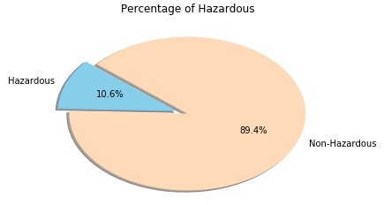
All the asteroids in the NASA database

Slide 9
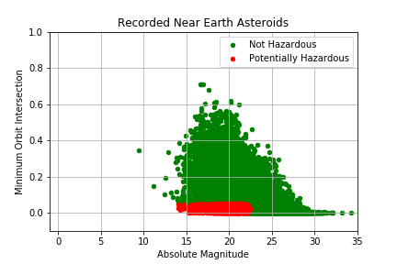
“Is potentially hazardous”
Notes:
For an asteroid to be potentially hazardous it has to have an absolute magnitude of 22 or less, with the smaller the number meaning the brighter the asteroid. For example the north star has an absolute magnitude of -3.64.

Slide 10
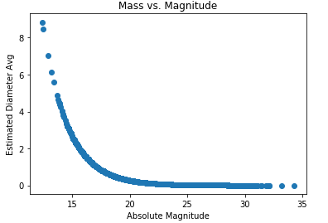
Is there a correlation between the size of the asteroid and the magnitude.
Notes:
One of the important factors for determining if an asteroid is potentially hazardous is the absolute magnitude of it.
The absolute magnitude actually has nothing to do with the size of the asteroid but rather has everything to do with how bright the asteroid is.

Slide 11

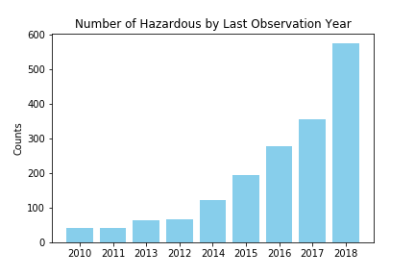
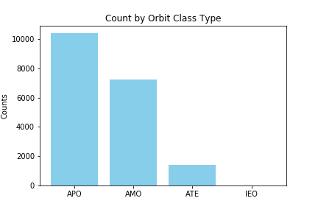

Slide 12
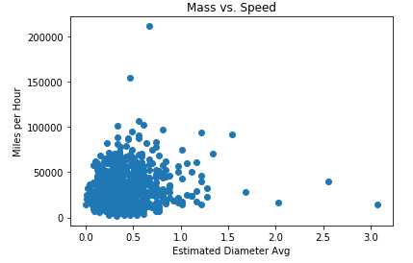
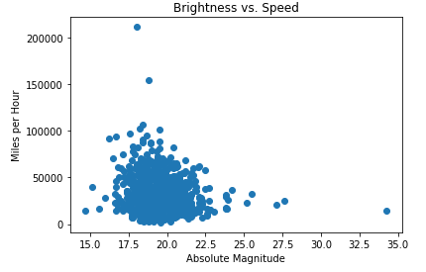

Slide 13
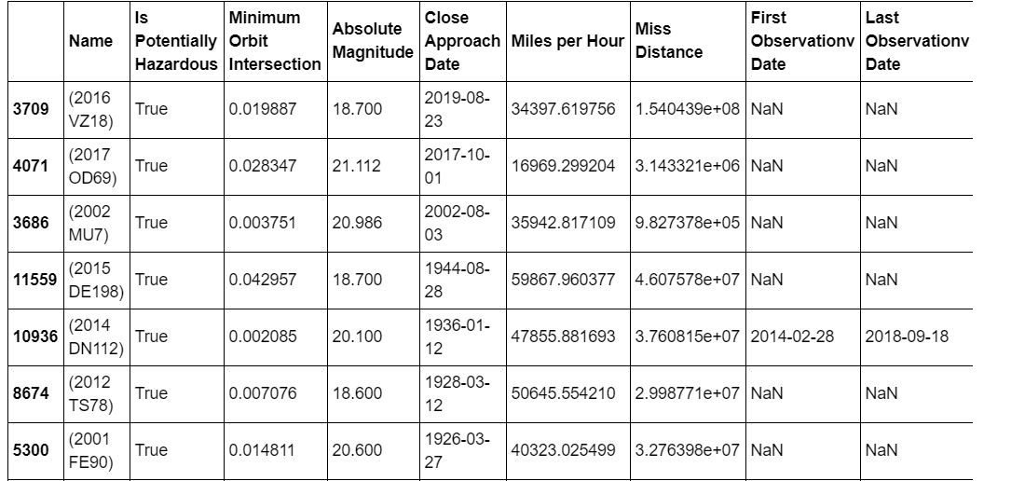

So when will the world end?
Based on the data we retrieved the next potentially hazardous asteroid will come in 2019 but is projected to miss us. Thankfully, so as of now we do not know.

Slide 14
Post Mortem
If we had more time some things we would look at
There’s an estimate of about 1.9 million asteroids in our solar system and NASA only has records of about 20,000. So look at other sources to see if there’s data on any more asteroids.
Look at the composition of the asteroids that increase the brightness so we could see what is in the brightness that makes them more dangerous.
Some hiccups along the way
We had a limit of 500 calls we could make per hour with the API so we made several keys to loop over the 900+ pages of data we had
There were missing values in some of the asteroids so we used exception handling to get through the key errors that would pop up.
Figuring out a way to loop through API keys as we looped through pages that we didn’t hit our limit.

Slide 15
Questions???

